Slide 1
User Interface Design

Slide 2
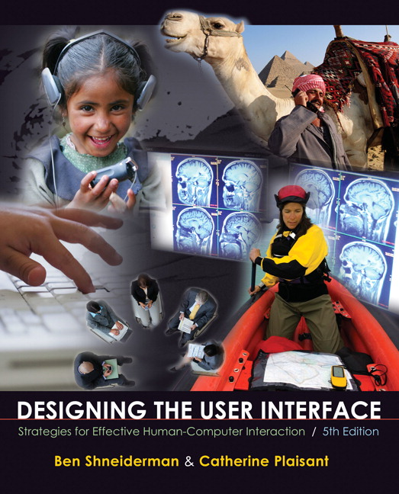
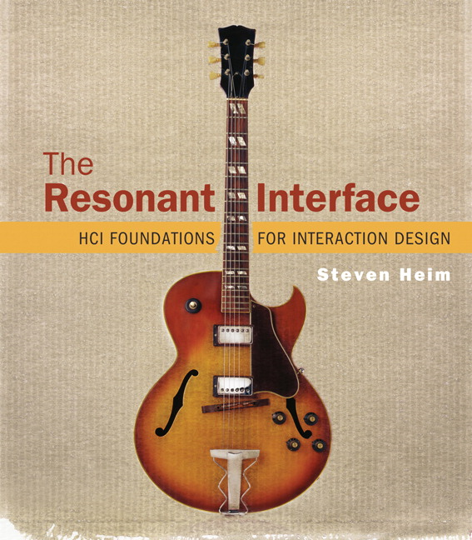
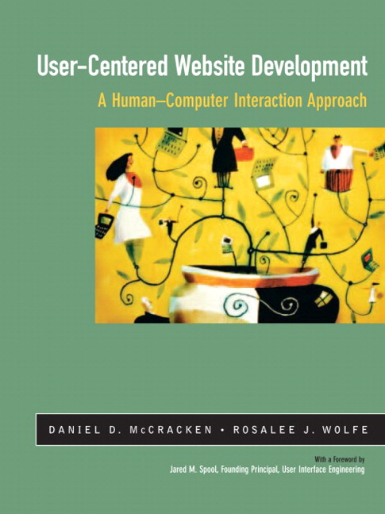
Acknowledgments
Most of the content in this presentation comes from three primary texts
Each is highly recommended

Slide 3
Introduction to HCI

Slide 4
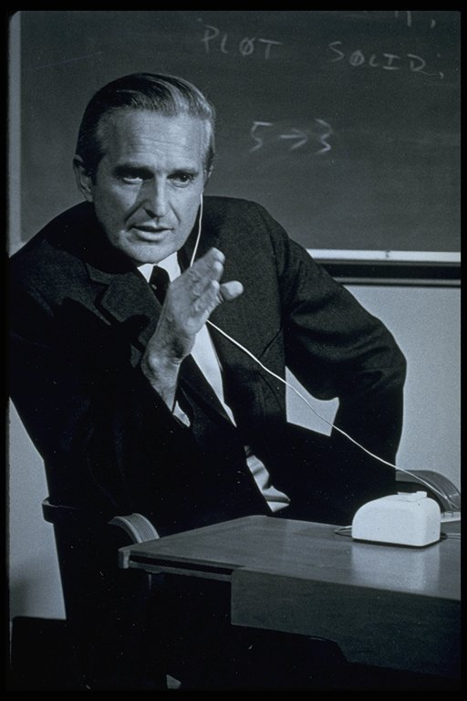
History - Douglas Engelbart
Human Augmentation System
It seemed clear to everyone else at the time that nobody would ever take seriously the idea of using computers in direct, immediate interaction with people. The idea of interactive computing—well, it seemed simply ludicrous to most sensible people. (Engelbart,1968)
Engelbart conducting a workshop - Circa 1967-68.
Courtesy Douglas Engelbart and Bootstrap Institute
http://www.dougengelbart.org/ - See the demo

Slide 5
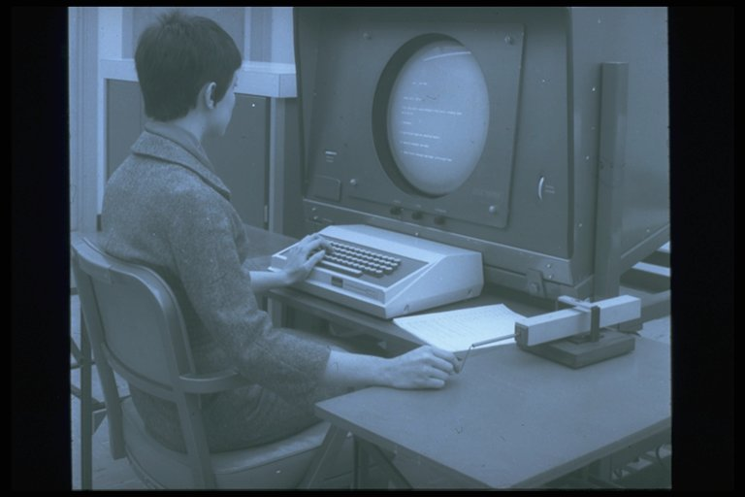
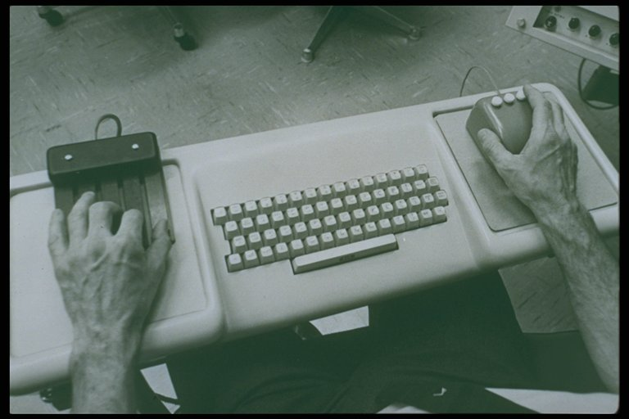
History - Douglas Engelbart
Human Augmentation System
First Mouse
NLS Mouse and workstation
Ergonomic Keyboard Console
Courtesy Douglas Engelbart and Bootstrap Alliance.

Slide 6
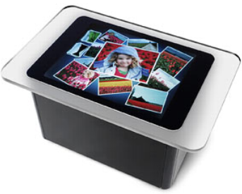
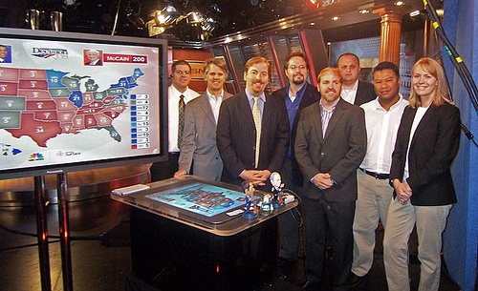
Now – Gestures and Touch
Products like Microsoft’s Surface are changing human-computer interaction today
multi-touch computer that responds to natural hand gestures and real-world objects, helping people interact with digital content in a simple and intuitive way

Slide 7
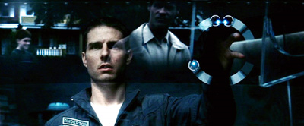
Future – UI from Minority Report
3D gesture-based interface with immersive video – see clip on YouTube
Image © 2002 DreamWorks LLC and Twentieth Century Fox
Starting to happen now – See Project Maestro from Cynergy Labs

Slide 8
What is HCI?
“Human Computer Interaction is a discipline concerned with the design, evaluation and implementation of interactive computing systems for human use and with the study of the major phenomena surrounding them.”
As defined by the Special Interest Group on Human-Computer Interaction (SIGCHI) of the Association for Computing Machinery (ACM)

Slide 9
Goals of HCI
To develop or improve the
Safety
Efficiency
Utility
Effectiveness
Usability
Appeal
. . . of systems that include computers

Slide 10
Goals of HCI
Safety
Safety of Users—think of
Air traffic control
Hospital intensive care
Safety of Data—think of
Protection of files from tampering
Privacy and security
Efficiency
A measure of how quickly users can accomplish their goals or finish their work using the system

Slide 11
Goals of HCI
Utility: what services a system provides; examples:
Information
Instruction
Purchases
Effectiveness: user’s ability to achieve goals; examples:
Find desired information
Enter credit card data
They are distinct
A web site might provide all necessary services, but if users can’t find the items they want to buy, the site lacks effectiveness

Slide 12
Goals of HCI
Usability
Ease of learning
Ease of use
Can be an entire graduate course!
Appeal
How well users like the system
First impressions
Long-term satisfaction

Slide 13
Fields that HCI builds on
Computer Science
Implementation of website or other interface
Engineering
Faster, cheaper equipment
Ergonomics
Design for human factors
Graphic design
Visual communication
Technical writing
Textual communication
Linguistics, artificial intelligence
Speech recognition, natural language processing
Cognitive psychology
Perception, memory, mental models
Sociology
How people interact in groups
Anthropology
Study of people in their work settings
A highly eclectic field, obviously, which offers both challenges and satisfactions

Slide 14
Benefits of Usable Systems
Gaining a competitive edge
Reducing development and maintenance costs
Improving productivity
Lowering support costs

Slide 15
Benefits: Gaining a competitive edge
Think of a B2C web site
Conversion rate is the percentage of visitors who take an action you want them to take, such a making a purchase
Increasing the conversion rate lowers the cost of individual sales
Ease of use is the most important driver of high conversion rates
And there is gold in improving the conversion rate, which was 3.2% in May, 2003

Slide 16
Benefits: Reducing development and maintenance costs
Learn about users first, and you will avoid
Implementing features users don’t want
Creating features that are annoying or inefficient
High cost of making changes late in the development cycle

Slide 17
Benefits: Improving productivity
For e-commerce, productivity means that users find what they want—and succeed in buying it
For a company intranet, productivity means employees become more efficient

Slide 18
Benefits: Lower support costs
Calls to customer support are very expensive for the vendor: estimates range from $12 to $250 per call
A website that reduces support calls can save major dollars

Slide 19
How do we make computers easy to use?
By applying the principles of Human-Computer Interaction
By being, as an HCI practitioner, the advocate for the user

Slide 20
User-Centered Development Methodology
User-centric, not data-centric
Involves users in the design process
Usability can be quantified and measured
Highly Iterative
Involves testing and revision
Interdisciplinary and eclectic, building on a dozen different disciplines

Slide 21
Characteristics of User-Centered Development
Highly iterative
DESIGN
PROTOTYPE
EVALUATE
MEET USER
SPECIFICATIONS?
READY TO
IMPLEMENT
NO
YES

Slide 22
Prototyping
Prototype is an original model or pattern
Global: entire site
Local: selected parts of the site
Prototypes
Evolutionary: becomes the final project
Throw-away: serves as a pattern
High fidelity: resembles final product
Low fidelity: just rough sketch - not close to final

Slide 23
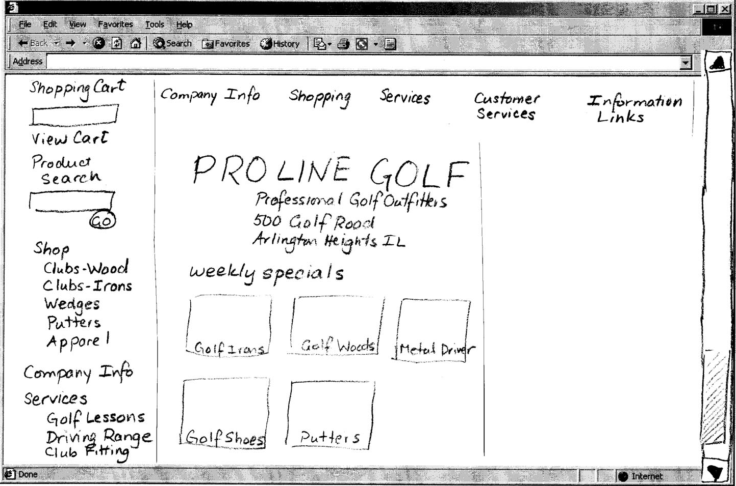
A low-fidelity prototype

Slide 24
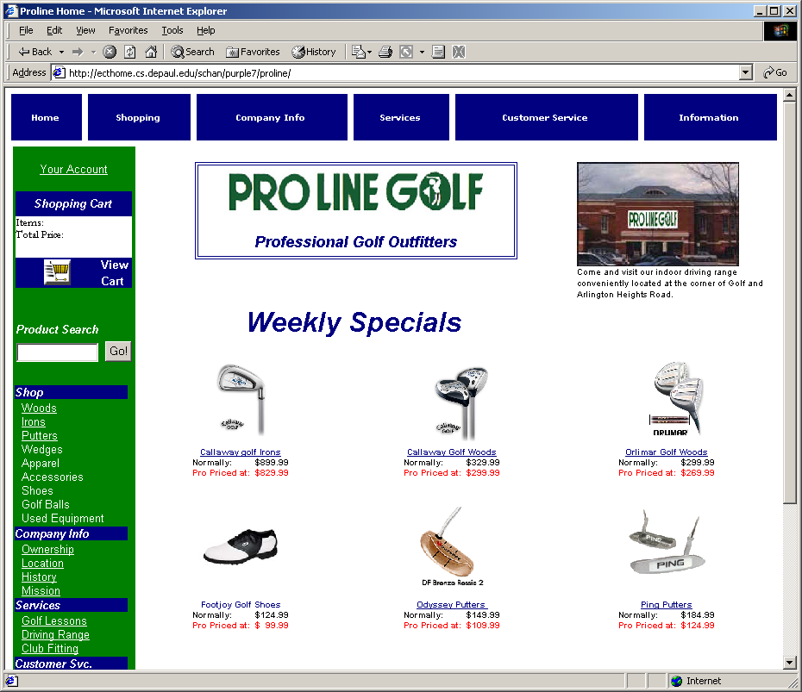
A high-fidelity prototype

Slide 25
Capabilities of People

Slide 26
Why do we care?
Because when people try to understand something, they use a combination of
What their senses are telling them
The past experience they bring to the situation
Their expectations

Slide 27
Senses
Senses (sight, hearing, smell, taste, touch) provide data about what is happening around us
We are visual beings (“See what I mean?”)
Designing good Web materials requires knowledge about how people perceive

Slide 28
Constructivism
Our brains do not create pixel-by-pixel images
Our minds create, or construct, models that summarize what comes from our senses
These models are what we perceive
When we see something, we don’t remember all the details, only those that have meaning for us

Slide 29
Example: familiar objects that we see, but don’t store in detail
How many links are there on top menu of amazon.com?
What are the colors on your favorite cereal box?
How many lines are there in the IBM logo?
Who cares?
Moral: People filter out irrelevant factors and save only the important ones

Slide 30
Context
Context plays a major role in what people see in an image
Mind set: factors that we know and bring to a situation
Mind set can have a profound effect on the usability of a web site

Slide 31
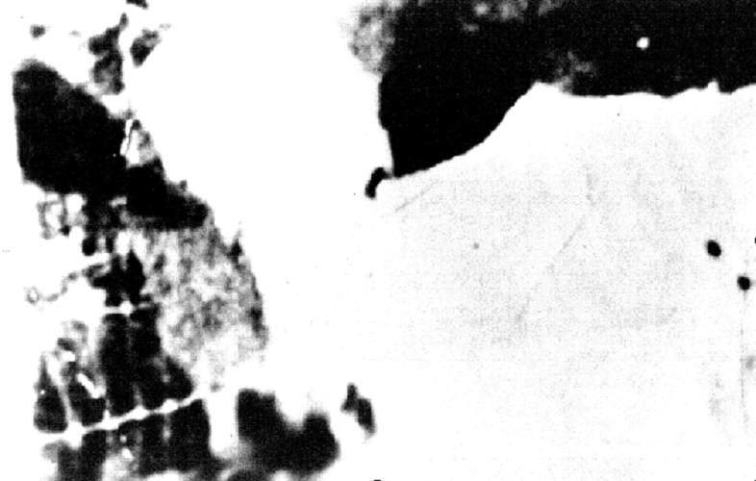
Example of context: What do you see?

Slide 32
Hint: it’s an animal, facing you . . .

Slide 33
Hint: this animal gives milk, and her face takes up the left half of the picture . . .

Slide 34
Why couldn’t you see the cow’s face at first?
It’s blurry and too contrasty, of course, but more:
You had no idea what to expect, because there was no context
Now that you do have a context, you will have little difficulty recognizing it the next time

Slide 35
Figure and ground
Images are partitioned into
Figure (foreground) and
Ground ( background)
Sometimes figure and ground are ambiguous

Slide 36

Figure and ground: What do you see?

Slide 37
Five principles of Gestalt psychology
We organize things into meaningful units using
Proximity: we group by distance or location
Similarity: we group by type
Symmetry: we group by meaning
Continuity: we group by flow of lines (alignment)
Closure: we perceive shapes that are not (completely) there

Slide 38
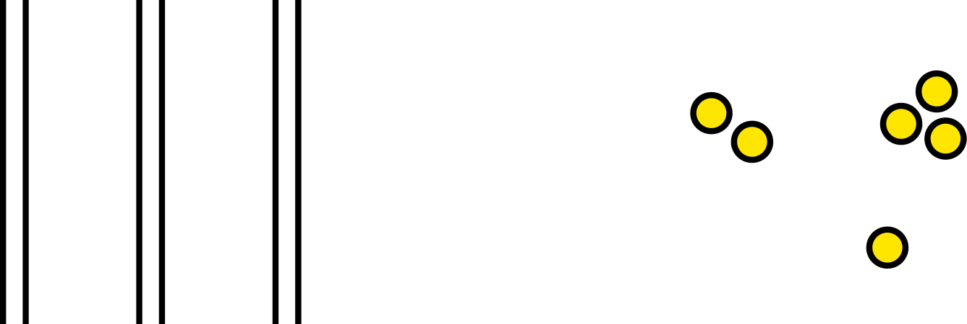
Proximity

Slide 39
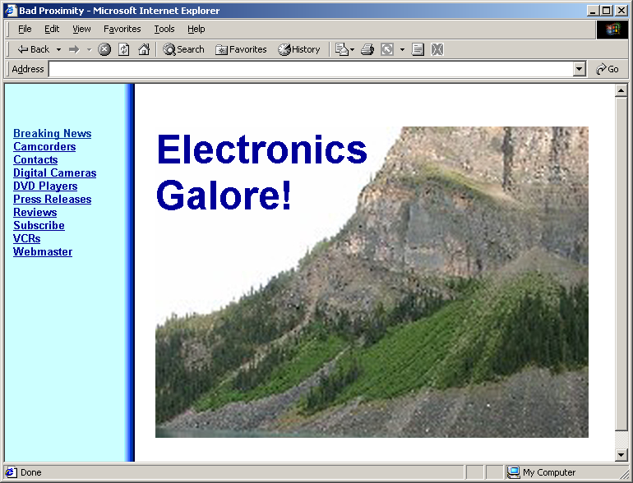
Example: a page that can be improved . .

Slide 40
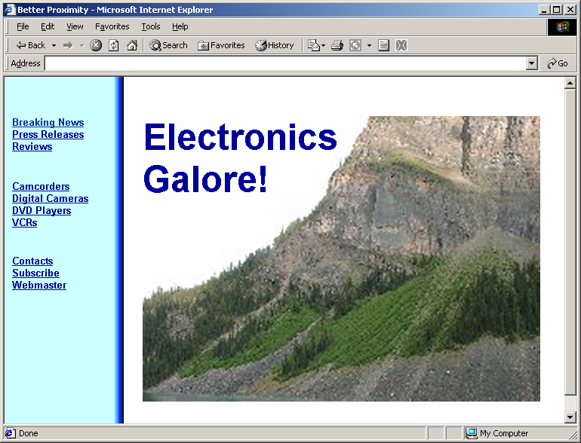
By using proximity to group related things

Slide 41
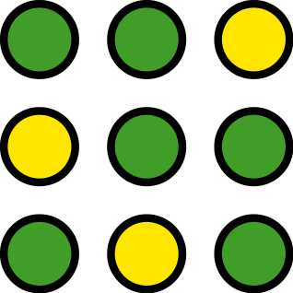
Similarity

Slide 42
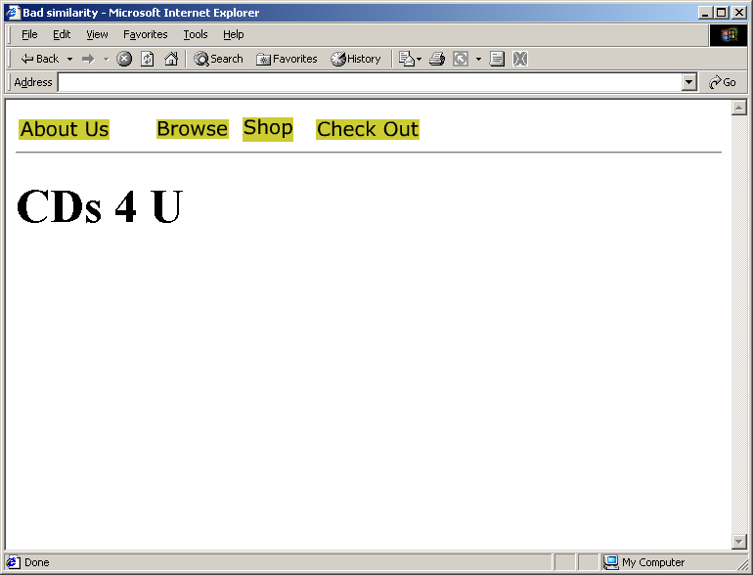
Example: can you use similarity to improve this page?

Slide 43
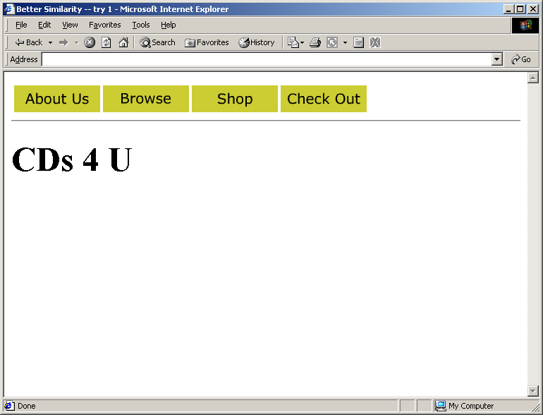
Sure: make the buttons the same size:

Slide 44
Anything else?

Slide 45
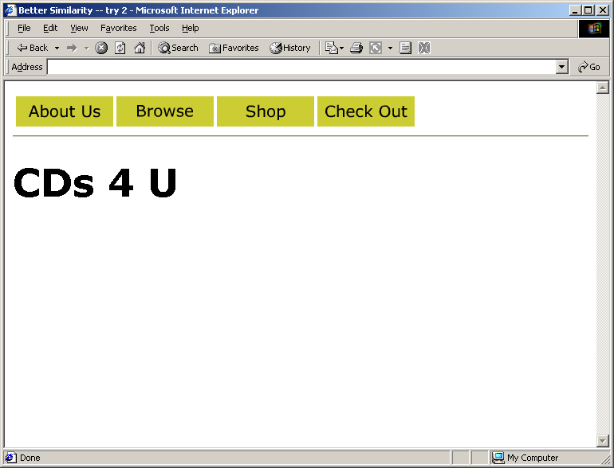
Sure: use the same font everywhere:

Slide 46

Symmetry: we use our experience and expectations to make groups of things
Two triangles?
Three groups of paired square brackets?

Slide 47
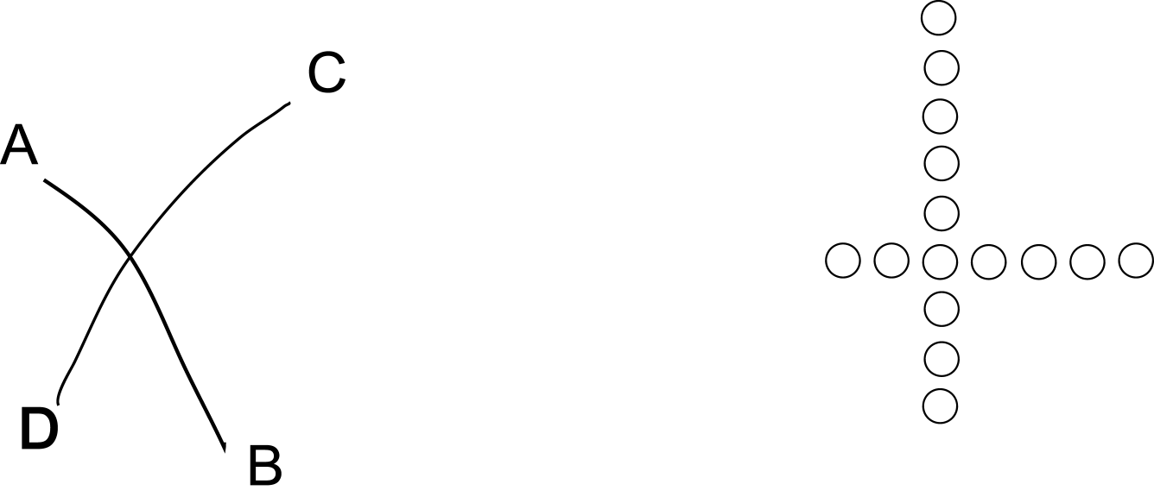
Continuity: flow, or alignment
Curves AB and CD, not AC and DB, and not AD and BC?
Two rows of circles, not two L-shaped groups?

Slide 48
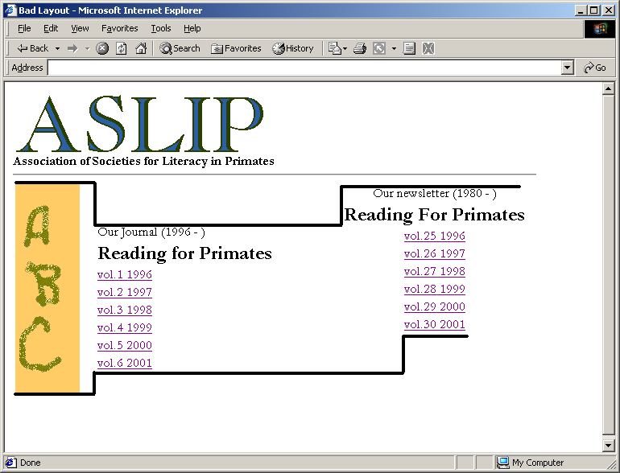
Can you use alignment (one form of continuity) to improve this page?

Slide 49
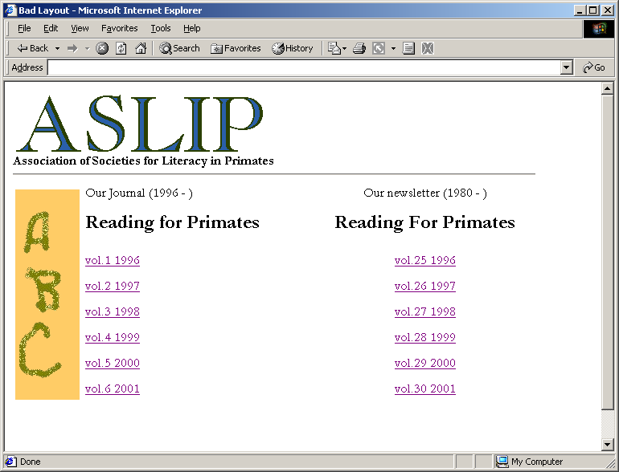
Sure: the lines on the previous slide show how to use horizontal alignment

Slide 50
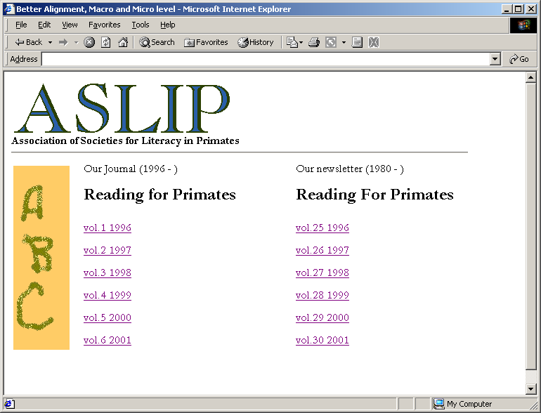
But why stop? Left-align both columns to get vertical alignment also

Slide 51

Closure: we mentally “fill in the blanks”
All are seen as circles

Slide 52
Memory
Hierarchical Model
Sensory
Practice and effort needed to make this transfer ➔
Short Term
Long Term

Slide 53
“The Magic Number 7, Plus or Minus 2” George Miller, 1956
Value of “ chunking”
2125685382 vs. 212DanHome
10 chunks vs. 3 (assuming 212 is familiar)
Can you remember:
Vsdfnjejn7dknsdnd33s

Slide 54
How many chunks in . . .
www.bestbookbuys.com
20? Not really:
www.
best
book
buys
.com

Slide 55
Recognition vs. recall
Why is a multiple choice test easier than an essay test?
Multiple choice: you can recognize the answer
Essay: you must recall the answer
A computer with a GUI allows us to recognize commands on a menu, instead of remembering them as in DOS and UNIX

Slide 56
Mental Models
How do people use knowledge to understand or make predictions about new situations?
People build mental models
For example, a car: put gas in, turn key, and it runs. (Not exactly a car mechanic’s model!)
Can’t ignore user’s mental model
And how do we know what the users’ mental models are?
Through user testing

Slide 57
Metaphors
Way to relate a difficult or more abstract concept to a familiar one
Open file
Save file

Slide 58

Metaphors have problems
Disadvantage: metaphor may not be widely known or correctly understood
The mailbox icon meant nothing outside rural United States until explained. And it’s backwards: we put the flag up to tell the mailman that we have put mail in the box to be picked up.

Slide 59
Affordance
Affordance: “The functions or services that an interface provides”
A door affords entry to a room
A radio button affords a 1-of-many choice
On a door, a handle affords pulling; a crash bar affords pushing

Slide 60
Perceived affordance
We want affordance to be visible and obvious to the user
The Up and Down lights on an elevator door should have arrows, or they should be placed vertically so that the top one means Up
On a car, turning the steering wheel to the left makes the car go left

Slide 61
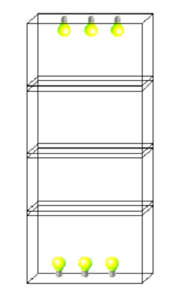
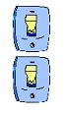
Example of perceived affordance
Top switch controls top lights
By convention, with a light switch “up” is “on”

Slide 62
User Interaction

Slide 63
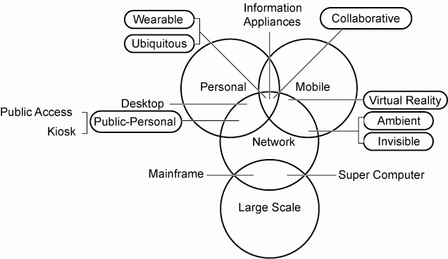
Interaction Paradigms
Large circles represent principal paradigms.
Oblong shapes represent convergent paradigms.
Words without surrounding shapes represent specific system architectures
(sometimes used for a paradigm reference, as in desktop computing for personal computing).

Slide 64
Execution/Evaluation Action Cycle
Donald Norman (1990) The Design of Everyday Things
The structure of an action has four basic parts:
Goals: We begin with some idea of what we want to happen; this is our goal.
Execution: We must then execute an action in the world.
World: To execute and action, we must manipulate objects in the world.
Evaluation: Finally, we must validate our action and compare the results with our goal.

Slide 65
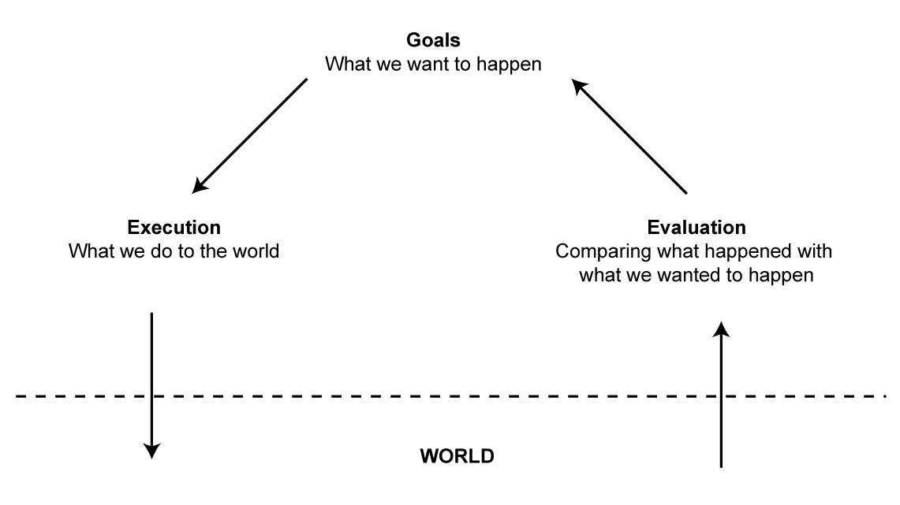
Execution/Evaluation Action Cycle

Slide 66
Execution/Evaluation Action Cycle
Goals do not specify particular actions
Goals and intentions do not have a one-to-one, relationship
“Delete text” goal
Intention that involves the Edit menu
Intention that involves the Delete key
Each intention involves a sequence of actions
Goal > Intention > Actions > Execution

Slide 67
Execution/Evaluation Action Cycle
Evaluate Results
Perceive new state
Interpret what we perceive
Evaluate new state with goal
Perceive > Interpret > Evaluate

Slide 68
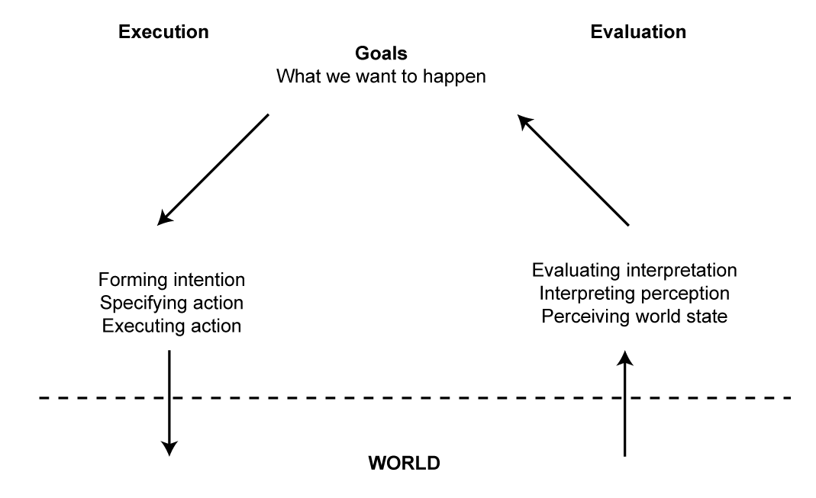
Execution/Evaluation Action Cycle
Seven Stages of Action

Slide 69
Execution/Evaluation Action Cycle
Four principles of good design
State and the action alternatives should be visible
Should be a good conceptual model with a consistent system image
Interface should include good mappings that reveal the relationships between stages
User should receive continuous feedback
Four critical points where user failures can occur
Users can form an inadequate goal
Might not find the correct interface object because of an incomprehensible label or icon
May not know how to specify or execute a desired action
May receive inappropriate or misleading feedback

Slide 70
Common Interaction Styles
Command Line (or Command Language)
Menu-Based Interface
Form Fill-In
Question and Answer
Direct Manipulation
Metaphors
Web Navigation
Natural Language

Slide 71
Interaction Styles - Command Line
Command-line interfaces are fast and powerful
Many commands are abbreviated
quick and efficient
Commands can be applied to many objects simultaneously
fast input
Some commands have multiple parameters that can be set and altered
precise and flexible

Slide 72
Interaction Styles - Command Line
Command Line and the EEAC
Intention formation, specification of the action, and the execution stages are complex
Requires a rather accurate mental model of the computer’s internal processing
Command Line and the Interaction Framework
Translating the user’s task language into the input language requires knowledge of the core language
The output language can be confusing for inexperienced users - there is very little feedback

Slide 73
Interaction Styles - Command Line
Advantages of command-line interfaces:
Suitable for repetitive tasks
Advantageous for expert users
Offer direct access to system functionality
Efficient and powerful
Not encumbered with graphic controls
Low visual load
Not taxing on system resources

Slide 74
Interaction Styles - Command Line
Disadvantages of command-line interfaces:
Low command retention
Steep learning curve
High error rates
Heavy reliance on memory
Frustrating for novice users

Slide 75
Interaction Styles - Menu-Based Interface
Menu-driven interfaces present users with sequential hierarchal menus that offer lists of functions.
Textual: key-in number of option
Graphical: use arrow keys or pointing device

Slide 76
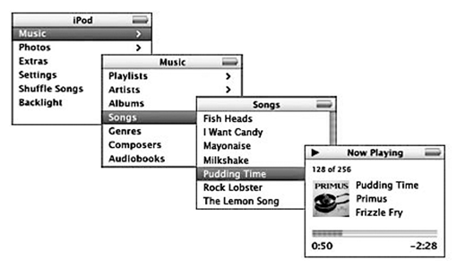
Interaction Styles - Menu-Based Interface
Menus are based on recognition as opposed to recall
No need to remember commands
Users search from a list of possible choices
List provides constraints
Appropriate for small screens (iPod)

Slide 77
Interaction Styles - Menu-Based Interface
Menu-based interfaces and the EEAC
Menu constraints can help the user to form the proper intentions and specify the proper action sequence
Provide a context to evaluate the output language

Slide 78
Interaction Styles - Menu-Based Interface
Menu-based interfaces and :
Mental Models
Menu construction has a direct impact on user’s mental model
Affordances
Menu elements present affordances

Slide 79
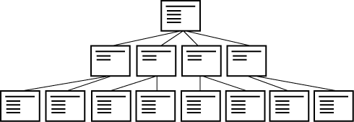


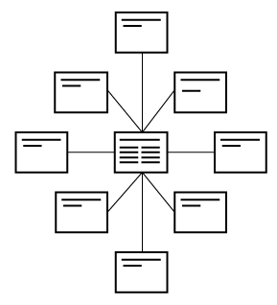
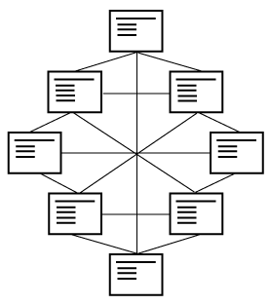
Interaction Styles - Menu-Based Interface
Most menus are a variation on a few basic categories:
Single Sequential Hierarchal
Star network Web network

Slide 80
Interaction Styles - Menu-Based Interface
Advantages of menu-based interfaces:
Low memory requirements
Self-explanatory
Easy to undo errors
Appropriate for beginners
Disadvantages of menu-based interfaces:
Rigid and inflexible navigation
Inefficient for large menu navigation
Inefficient use of screen real estate
Slow for expert users

Slide 81
Interaction Styles - Question and Answer
Question and answer interfaces are also called wizards
They are restricting for expert users
They are easy for novice users
However, they may not know the required information

Slide 82
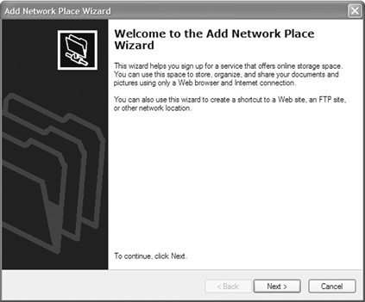
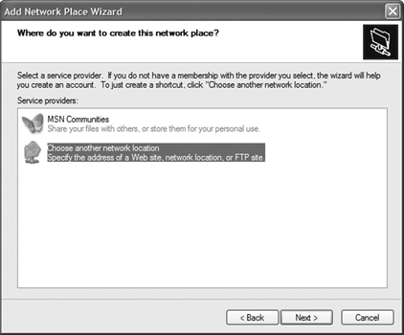
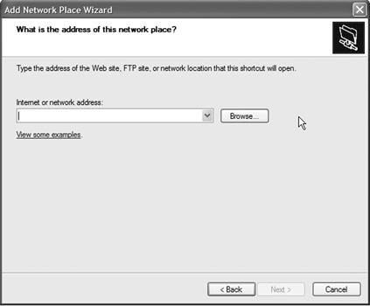
Interaction Styles - Question and Answer
Microsoft Add Network Place Wizard
(a) Add Network Place wizard. (b) Select a service provider. (c) Address of the network place.

Slide 83
Interaction Styles - Question and Answer
Advantages of question and answer interfaces:
Low memory requirements
Self-explanatory
Simple linear presentation
Easy for beginners
Disadvantages of question and answer interfaces:
Require valid input supplied by user
Require familiarity with interface controls
Can be tedious to correct mistakes

Slide 84
Interaction Styles - Direct Manipulation
Ben Shneiderman (1982)
Continuous representations of the objects and actions of interest with meaningful visual metaphors
Physical actions or presses of labeled buttons instead of complex syntax
Rapid, incremental, reversible actions whose effects on the objects of interest are visible immediately

Slide 85
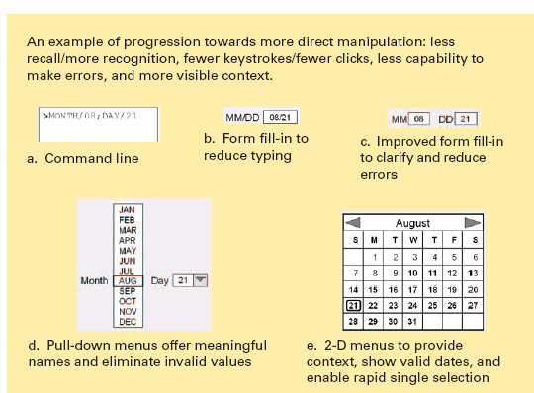
Spectrum of Directness

Slide 86
Interaction Styles - Direct Manipulation
Direct Manipulation and the EEAC
The range of possible intentions is consistently wide
Users usually have multiple options for specifying action sequences
Can be overwhelming of novice users
Provide multiple ways of executing action sequences

Slide 87
Interaction Styles - Direct Manipulation
Advantages of direct manipulation interfaces:
Easy to learn
Low memory requirements
Easy to undo
Immediate feedback to user actions
Enables user to use spatial cues
Easy for beginners
Disadvantages of direct manipulation interfaces:
Not self-explanatory
Inefficient use of screen real estate
High graphical system requirements

Slide 88
Interaction Styles - Metaphors
GUIs use visual relationships to real-world objects (metaphors)
Metaphors can help people relate to complex concepts and procedures by drawing on real-world knowledge
Real-world affordances can be reflected
What metaphors are used by contemporary GUIs?

Slide 89
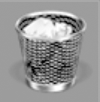

Interaction Styles - Metaphors
A metaphor’s function must be consistent with real-world expectations
Metaphors that do not behave the way people expect will cause confusion and frustration

Slide 90
Interaction Styles - Web Navigation
Two basic interaction styles
Link-based navigation
Search
Slight advantage in development of mental models
Has Google ruined us on using link-based navigation?

Slide 91
Interaction Styles – 3D Environments
3D interaction is natural in the real-world
3D environments are common in digital games
Rich graphical 3D environment are processor intensive

Slide 92
Interaction Styles - Natural Language
Natural Language Interaction (NLI) - Interacting with computers using everyday language
Obstacles
Language is ambiguous
Meaning depends on context
“Search results”
“She said she did not know”
Dependant on visual cues

Slide 93
Interaction Styles - Natural Language
Applications for NLI
Speech Input
Hands-free operation
Poor Lighting Situations
Mobile Applications
In the home
Speech Output
On-board navigational systems

Slide 94
Interaction Styles - Natural Language
Advantages of NLI:
Ease of learning
Low memory requirements
Flexible interaction
Low screen requirements
Appropriate for beginners
Disadvantages of NLI:
Requires knowledge of the task domain
May require tedious clarification dialogues
Complex system development

Slide 95
Usability

Slide 96
Usability requirements
The U.S. Human Engineering Design Criteria for Military Systems (1999) states these purposes:
Achieve required performance by operator, control, and maintenance personnel
Minimize skill and personnel requirements and training time
Achieve required reliability of personnel-equipment/software combinations
Foster design standardization within and among systems
Usability requires project management and careful attention to requirements analysis and testing for clearly defined objectives

Slide 97
Goals for requirements analysis
Ascertain the user’s needs
Determine what tasks and subtasks must be carried out
Include tasks which are only performed occasionally
Common tasks are easy to identify
Functionality must match need or else users will reject or underutilize the product

Slide 98
Goals for requirements analysis
Ensure reliability
Actions must function as specified
Database data displayed must reflect the actual database
Appease the user's sense of mistrust
The system should be available as often as possible
The system must not introduce errors
Ensure the user's privacy and data security by protecting against unwarranted access, destruction of data, and malicious tampering

Slide 99
Goals for requirements analysis
Promote standardization, integration, consistency, and portability
Standardization: use pre-existing industry standards where they exist to aid learning and avoid errors (e.g. the W3C and ISO standards)
Integration: the product should be able to run across different software tools and packages (e.g. Linux)
Consistency:
compatibility across different product versions
compatibility with related paper and other non-computer based systems
use common action sequences, terms, units, colors, etc. within the program
Portability: allow for the user to convert data across multiple software and hardware environments (e.g. iPhone)

Slide 100
Usability measures
Define the target user community and class of tasks associated with the interface
Communities evolve and change
5 human factors central to community evaluation:
Time to learn How long does it take for typical members of the community to learn relevant task?
Speed of performance How long does it take to perform relevant benchmarks?
Rate of errors by users How many and what kinds of errors are made during benchmark tasks?
Retention over time Frequency of use and ease of learning help make for better user retention
Subjective satisfaction Allow for user feedback via interviews, free-form comments and satisfaction scales

Slide 101
Usability measures
Trade-offs in design options frequently occur
Changes to the interface in a new version may create consistency problems with the previous version, but the changes may improve the interface in other ways or introduce new needed functionality
Design alternatives can be evaluated by designers and users via mockups or high-fidelity prototypes
The basic tradeoff is getting feedback early and perhaps less expensively in the development process versus having a more authentic interface evaluated

Slide 102
Usability motivations
Many interfaces are poorly designed and this is true across domains:
Life-critical systems
Air traffic control, nuclear reactors, power utilities, police & fire dispatch systems, medical equipment
High costs, reliability and effectiveness are expected
Long training periods are acceptable despite the financial cost in order to provide error-free performance and avoid the low frequency but high cost errors
Subject satisfaction is less an issue due to well motivated users

Slide 103
Usability motivations
Industrial and commercial uses
Banking, insurance, order entry, inventory management, reservation, billing, and point-of-sales systems
Ease of learning is important to reduce training costs
Speed and error rates are relative to cost
Speed of performance is important because of the number of transactions
Subjective satisfaction is fairly important to limit operator burnout

Slide 104
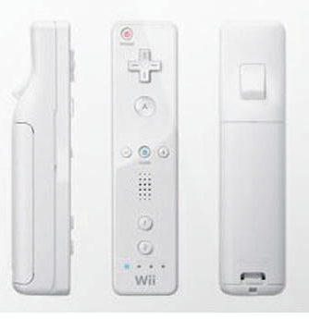
Usability motivations
Office, home, and entertainment applications
Word processing, electronic mail, computer conferencing, and video game systems, educational packages, search engines, mobile device, etc.
Ease of learning, low error rates, and subjective satisfaction are paramount due to use is often discretionary and competition fierce
Infrequent use of some applications means interfaces must be intuitive and easy to use; online help is important
Choosing functionality is difficult because the population has a wide range of both novice and expert users
Competition necessitates low cost
New games and gaming devices!
For example, Nintendo Wii’s interface

Slide 105
Usability motivations
Exploratory, creative, and cooperative systems
Web browsing, search engines, artist toolkits, architectural design, software development, music composition, and scientific modeling systems
Collaborative work
Benchmarks are hard to describe for exploratory tasks and device users
With these applications, the computer should be transparent so that the user can be absorbed in their task domain

Slide 106
Determine user’s skill levels
“Know thy user”
Age, gender, physical and cognitive abilities, education, cultural or ethnic background, training, motivation, goals and personality
Design goals based on skill level
Novice or first-time users
Knowledgeable intermittent users
Expert frequent users
Multi-layer designs

Slide 107
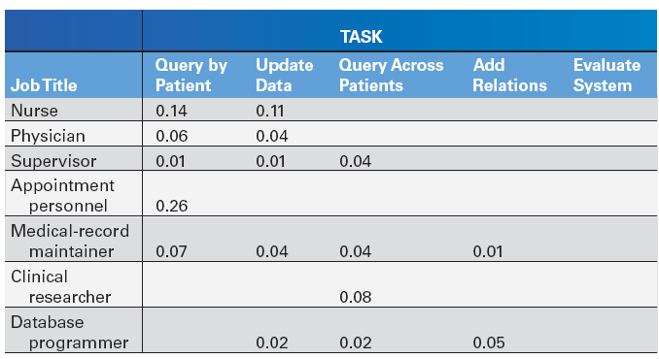
Identify the tasks
Task Analysis usually involve long hours observing and interviewing users
Decomposition of high level tasks
Relative task frequencies

Slide 108
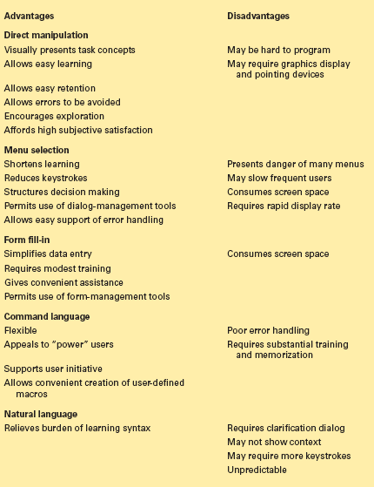
Choose an interaction style
Direct Manipulation
Menu selection
Form fill-in
Command language (line)
Natural language

Slide 109
The 8 golden rules of interface design
Shneiderman’s updated rules (referenced in Killer Robot)
Strive for consistency
Cater to universal usability
Offer informative feedback
Design dialogs to yield closure
Prevent errors
Permit easy reversal of actions
Support internal locus of control
Reduce short term memory load

Slide 110
Design Guidelines for the Web
Lessen burden on user’s memory:
Use recognition instead of recall
Help users chunk information
Require as little short-term memory as possible
Consider user’s mental models
Provide visual clues and memory aids
Provide feedback: let users know their input was received

